Slide 1
A new proof
of the Jury test
Students:
Saverio Borrelli
Luca Tirel
Ali

Slide 2
Contents
1 ) Introduction
2) Jury Test
3) Definitions and Preliminary Results
4) Propositions and proofs
5) The New Proof
6) Singular Cases 7)Examples and Code 8) Conclusions

Slide 3
1.
Introduction
1.Introduction
Introduction of the paper

Slide 4
Introduction
Contents
1.Introduction
The Jury test is the discrete time counterpart of the Routh-Hurwitz criterion
The authors of the paper deals with a proof of the Jury test, that is based on the Raible’s table. The new proof deals with the proprieties of root loci of associated polynomial.
The aim of the test is to assess the stability of a given polynomial, by determining the roots distribution with respect to the unit circle

Slide 5
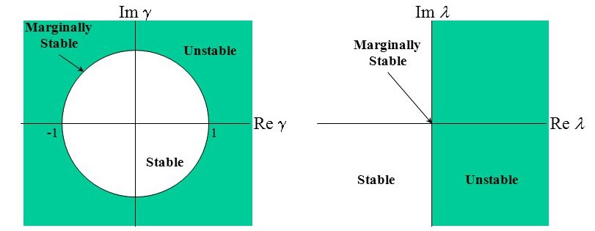
The stability
Discrete time vs Continuous time
1.Introduction
Discrete time
Continuous time

Slide 6
The idea
1.Introduction
The main idea behind the Jury test is to send sequentially only one branch of the locus to the origin, removing the root in zero, and generate a polynomial of lower degree from the coefficients of the previous one.
The relations between the highest order coefficients of this sequence of polynomials will be used to assess the stability of the original one.

Slide 7


A brief comparison
1.Introduction
Given a polynomial (n=4) :
We can compose the different tables for the different stability test in the following way:
Routh-Hurwitz criterion
Continuous time
Jury criterion on Jury’s table
Discrete time
Jury criterion on Raible’s table
Discrete time
With the following relations holding between the coefficients:
Note that the methods have different conditions, due to the nature of different mapping (RHP or Unit Circle)

Slide 8
2.
The Jury Test
2.Jury Test

Slide 9
The Jury test
2.Jury Test
Starting points and Assumptions
We start defining a standard polynomial of degree n in the Z-Domain
Now let’s define the following assumptions needed for the proof:
The polynomial P(z) has real coefficients
The coefficient of highest order is not null
The coefficient of order zero is not null
The polynomial has no roots on the unit circle*
*This assumption will be strengthened by assuming no zero in the first column of the Raible’s table (regular case)

Slide 10



The Jury test
Construction of the sequence of polynomials
From the n-th order polynomial, a sequence of polynomials of lower order is constructed as follows:
2.Jury Test

Slide 11









The Jury test
Raible’s table construction
From the coefficients of these polynomials we construct the table as follows:
. . .
. . .
. . .
. . .
. . .
. . .
2.Jury Test

Slide 12

The Jury test
The Jury theorem
Having constructed the table, depending on the sign of the highest order polynomial coefficient of P(z), we have the following conclusions:
If > 0 :
If < 0 :
Where i(P) and o(P) denote the number of roots inside and outside the unit circle, and the sign operator return the number of positive or negative values.
2.Jury Test

Slide 13
3.
Definitions and preliminary results
3.Definitions and Preliminary Results

Slide 14



Definitions and preliminary results
Parametric families definition
Now we introduce the reverse polynomial of P(z) and two family of parametric polynomials associated with them.
The reverse polynomial
The parametric family of polynomials
The parametric family of reverse polynomials
with
3.Definitions and Preliminary Results

Slide 15


Definitions and preliminary results
Preliminary results
The following preliminary results regarding the family of polynomials will be proved in the next slide and are the following:
3.Definitions and Preliminary Results

Slide 16

Definitions and preliminary results
Preliminary results’ proof
The proof are straightforward when the parameter is set equal zero. When it is equal one we have the following:
The same reasoning can be applied to prove the results about the family of reverse polynomials, but eliding the coefficient of order n instead of that one of order zero.
3.Definitions and Preliminary Results

Slide 17
4.
Propositions and proofs
4.Proposition and Proofs

Slide 18
Propositions and proofs
Propositions (A,B,C)
The following propositions are needed for the theorem and must be proved:
if < 1:
1) is always of degree n for any value of the parameter
2) none of the n arcs corresponding to the root loci of the family cross the unit circle, for any value of the parameter
if > 1: 1) is always of degree n for any value of the parameter
2) none of the n arcs corresponding to the root loci of the family cross the unit circle, for any value of the parameter
and
4.Proposition and Proofs

Slide 19


Propositions and proofs
Proof of proposition A
We will now proof the first and second point of proposition A.
Let’s first consider the highest order coefficient of the parametric polynomial and define the following quantities:
Since < 1 and , the quantity x will always be strictly less than 1.
Therefore will always be true, since is different from zero for hypothesis (2). Therefore first point of A is proved.
4.Proposition and Proofs

Slide 20






Propositions and proofs
Proof of proposition A
Now we will prove the second point of proposition A.
Consider as the unit circle and assume the following absurd hypothesis :
This means that there exist a value of z on the unit circle that is a root of the parametric polynomial family, for some fixed lambda.
By repeating this reasoning for
we can conclude the following:
The absurd hypothesis imply the following two facts:
This may happen only on the unit circle, but it is in contrast with the hypothesis (4) of the paper, leading us to an absurd conclusion.
By isolating in the first and substituting in the second we obtain:
The quantity inside the square brackets is always different from zero from first point of proposition A.
4.Propositions and Proofs

Slide 21
Propositions and proofs
Proof of propositions B and C
Now we will prove the propositions B and C.
The proposition B is the dual problem of the proposition A and can be similarly proved.
The proposition C can be proved as follows, starting from the definition of the reverse polynomial:
If is a root of , then is a root of , by direct construction of the reverse polynomial.
Thus the following relations must hold and has been proved:
and
4.Propositions and Proofs

Slide 22

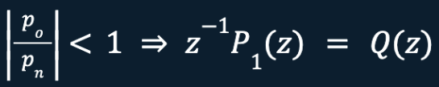
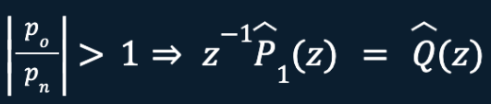
Propositions and proofs
Propositions D, E, F, G
D. Suppose that P(z) has i roots inside the unit circle and n-1 roots outside the unit circle. So we can have that:
If s
has i-1 roots inside the unit circle and n-1 roots outside the unit circle
E. Suppose that P(z) has i roots inside the unit circle and n-1 roots outside the unit circle. So we can have that:
If
has i-1 roots outside the unit circle and n-1 roots inside the unit circle
4.Propositions and Proofs

Slide 23

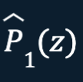
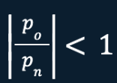


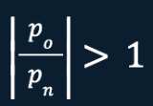
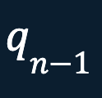

Propositions and proofs
Propositions D, E, F, G
F. and have the same set of roots
G. In this proposition we show an equivalence of the two conditions of before
The condition popn<1 is equivalent to the condition that qn-1 and pn are of the same sign.
The condition popn>1 is equivalent to the condition that qn-1 and pn are of the opposite sign.
4.Propositions and Proofs

Slide 24




Propositions and proofs
Proof of propositions D, E, F and G
Now we will prove the proposition D
Due to the proposition A, we have that the condition popn<1 ensures that no roots of P(z) = P(z)- popnznP(1z) cross the boundary
(it’s the unit circle for ).
Since we have that P1(z) has one root at the origin, so this root must be the terminal point of a root locus originating from a root of P(z) lying inside the unit circle.
So we have that z-1P1 :
Has precisely one less root (inside the unit circle) than P(z).
Has the same number of roots outside the unit circle
4.Propositions and Proofs

Slide 25
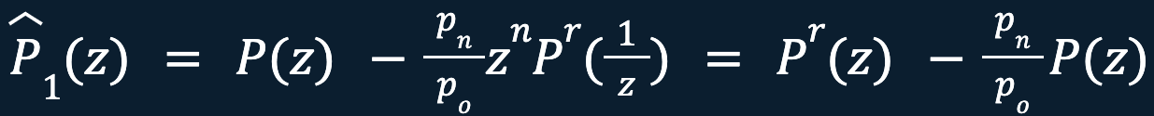
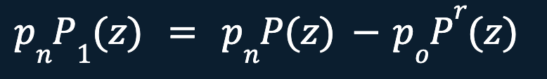
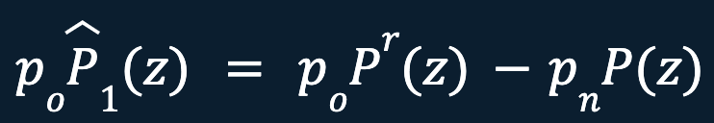


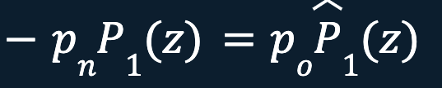
Propositions and proofs
Proof of propositions D, E, F and G
E) This proposition can is the dual of D, ant it can be easily proven
F) For proving this proposition we write the following equations
1)
2)
After some computations we obtain
1)
2)
So from these two we obtain
Consequently, since pn and po are non zero constants
so we have that P1(z) and P1(z) have the same set of roots
4.Propositions and Proofs

Slide 26
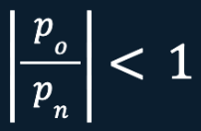
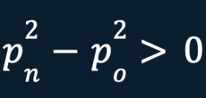
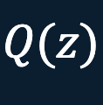
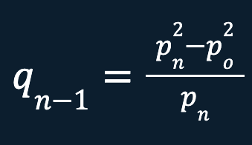
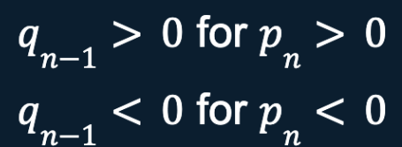
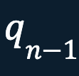



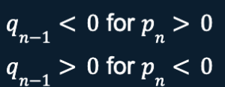
Propositions and proofs
Proof of propositions D, E, F and G
G)
If popn<1 so we have that pn2-po2>0.
Consequently it’s obvious that the highest order coefficient of Q(z) becomes:
And we have that:
So we can see that the sign of the denominator is predominant, and influences
the sign of qn-1.
If so we have that , then and we have that
4.Propositions and Proofs

Slide 27
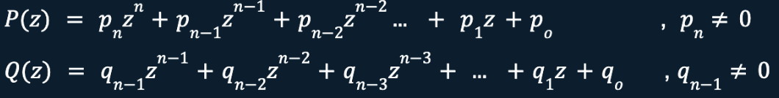
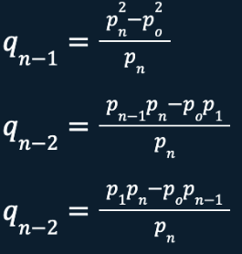







Lemma
Definition
Let:
With:
So we have that:
If :
If :
4.Propositions and Proofs

Slide 28

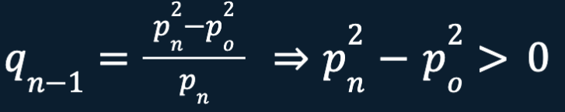
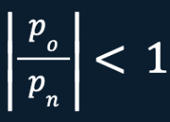


Lemma
Proof
Consider the case in which we have:
Since we have (from before): (or equivalently )
So from the proposition D:
Q(z) will have one less root inside the unit circle than P(z) , while the number of roots outside the unit circle remains the same.
And then:
If :
If :
4.Propositions and Proofs

Slide 29
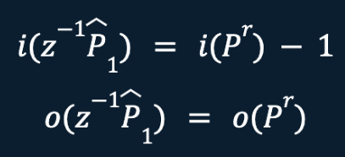
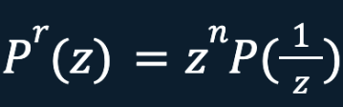
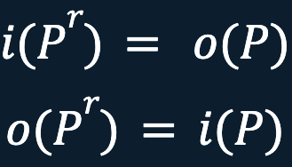
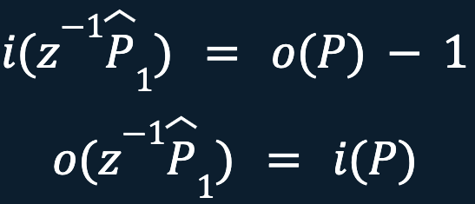

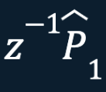




Lemma
Proof
Since , from D we have that
Now if we consider the the reverse polynomial we know that:
Therefore:
From proposition F, we have that and have the same set of roots.
So we will have also that:
where a sign change occurs between pn and qn-1
So we have that:
Have the same set roots
4.Propositions and Proofs

Slide 30
5.
The New Proof
5.The New Proof

Slide 31
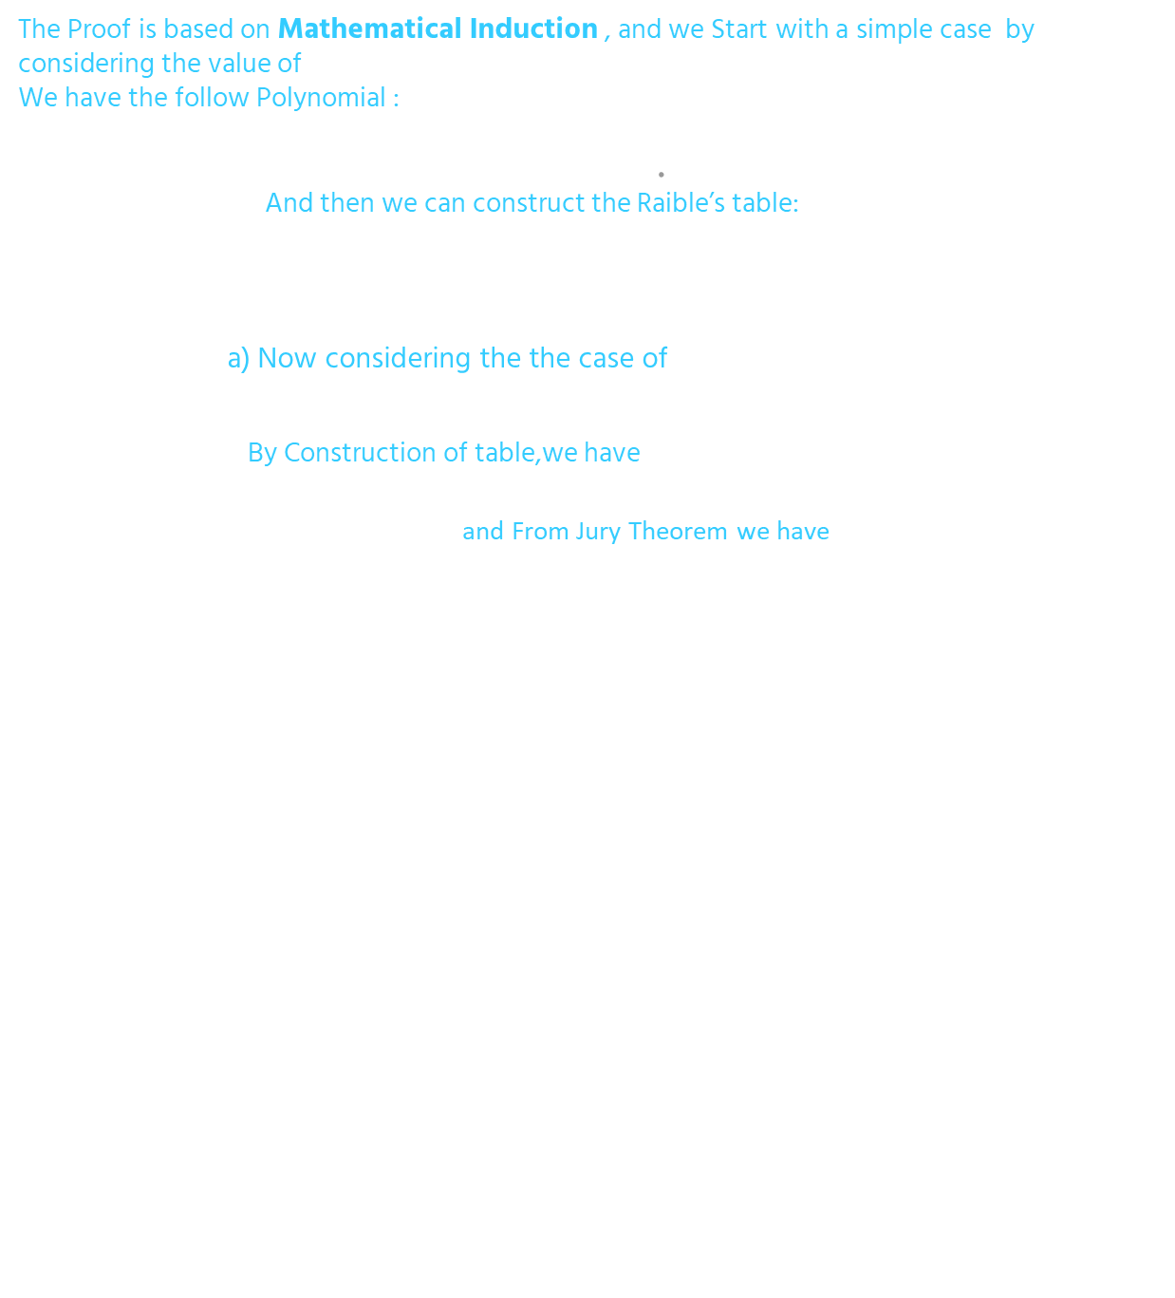

The New Proof
U(z) | u₁ | u₀
V(z) | v₀
5.The New Proof

Slide 32
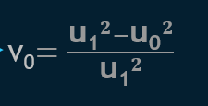

The New Proof
b) Now considering the case of u₁>0 & |u₀ /u₁| >1
By Construction of table, we have : v₀<0
and From Jury Theorem we have
which is exactly is the opposite of the previous case, from both a and b
We can confirm that the Jury theorem works perfectly at case of n=1 and
next we try to Generalize on the family of all Polynomial of degree n-1
5.The New Proof

Slide 33
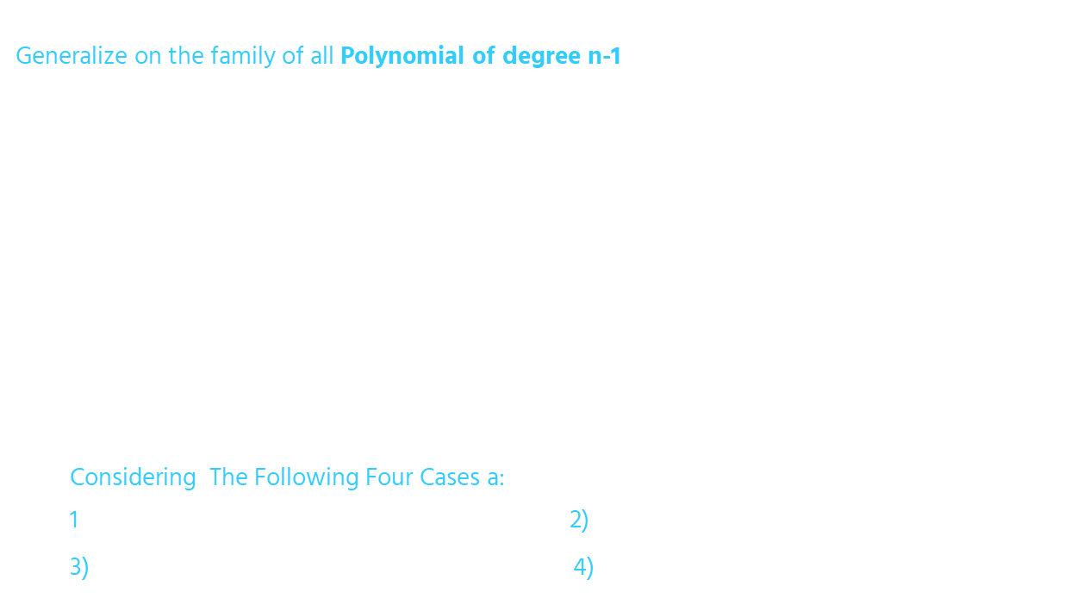

The New Proof
5.The New Proof

Slide 34


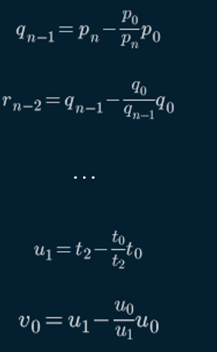
The New Proof
Q(z) will have one less root inside the unit circle than P(z) while the number of roots outside the unit circle remains the same.
5.The New Proof

Slide 35


The New Proof
.
5.The New Proof

Slide 36


The New Proof
.
5.The New Proof

Slide 37


The New Proof
5.The New Proof

Slide 38
6.
Singular Case
6.Singular Case

Slide 39

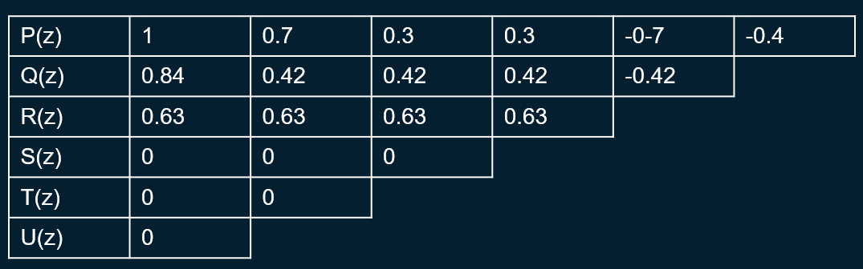

Singular Case
6.The Singular Case

Slide 40
7.
Examples and Code

Slide 41
Example and Code
7.Example and Code
Example
Now we will show an example of the Jury’s test on Raible’s table. Consider the following polynomial:
We can use the coefficients to construct the following Raible’s table:
P(z) | 1 | 0.9 | -1.12 | -2.504 | -1.5724 | -1.2327
Q(z) | 0.8576 | 0.3066 | -2.0650 | -2.9266 | -1.2327
R(z) | -0.9145 | -3.9005 | -5.0334 | -2.4860
S(z) | 5.8437 | 9.7829 | 5.57
T(z) | 0.5345 | 0.4581
U(z) | 0.1418

Slide 42
Example and Code
7.Example and Code
Example
Since from the table is clear that:
Indeed P(z) has the following roots:
Which verify the answer of the test.

Slide 43
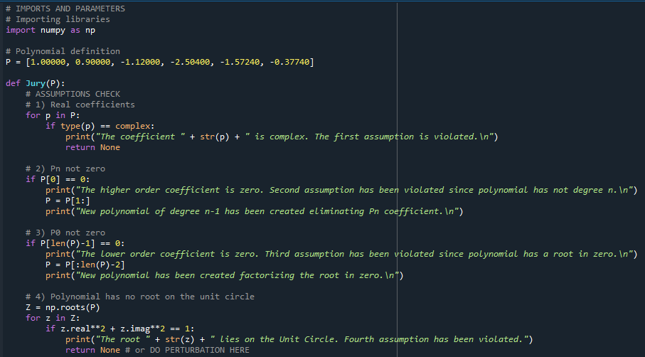
Example and Code
7.Example and Code
Code
We have build a small script in Python to create the Raible’s table starting from a polynomial, check the assumptions are not been violated, and execute the Jury test on the table:

Slide 44
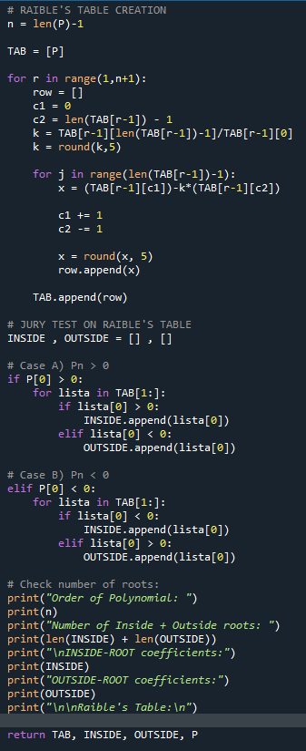
Example and Code
7.Example and Code
Code
And this is the code to compose the table and execute the test:

Slide 45
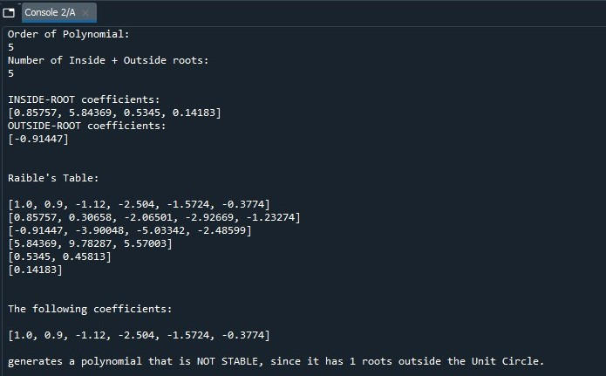
Example and Code
7.Example and Code
Code
The output of the script is the table and the stability of the given polynomial:

Slide 46
8.
Conclusions

Slide 47
Conclusions
8.Conclusions
As we’ve seen, the new proof of the Jury Test, exposed in the paper, shows the behavior of the roots of the sequence of polynomials constructed in the test.
It’s possible to do this by studying the root loci of the associated families of polynomials.
These results complement Jury’s original proof, which was based on the Rouchè’s theorem.
The original proof provides additional insight into the workings of the test.
The proof of the paper, instead, can be understood more easily, consequently it could be better for students.

